Slide 1

IMAGE CLASSIFICATION USING CONVOLUTION NEURAL NETWORK
Presented by:
Aabhushan Pokharel 45/BCT/2071
Prabin Bhusal 63/BCT/2071
Rajesh Mahato 67/BCT/2071

Slide 2
2
Introduction

Slide 3
3
Background
Human visual cortex is capable of recognizing and classifying a vast amount of objects that it encounters
Artificial Neural Network analogues Natural Neurons
Convolutional Neural Networks especially adapted for this task

Slide 4
4
Problem Statement
It’s becoming impossible for anyone to manually classify thousands of images.
If an automated system that can detect the object in the image and classify them is built, then this problem could be solved.

Slide 5
5
Objectives
To implement convolutional neural network to build an image classiﬁcation system

Slide 6
6
Application
Automated image organization
In stock photography websites for effective tagging
In large image databases

Slide 7
7
Features
Possible to classify different images in upto 10 classes

Slide 8
8
Feasibility Analysis
No additional hardware purchases required
The technical implementation of the software being developed is covered by existing technology
Resources are available as open source as well as the existence of an online community also helps in this regard
Can be developed with standard CPU

Slide 9
9
System Requirements
Hardware Requirements
Software Requirements
Intel i5 processor (recommended)
8GB RAM (recommended)
Nvidia GPU (optional)
Windows 7/8/10 64 bit or Mac OS X Lion or higher
Python 3.5
Keras 2.1 library
OpenCV library
Sklearn library
Numpy library

Slide 10
Literature Review

Slide 11
11
AlexNet
In 2012, it won the ImageNet Large Scale Visual Recognition Challenge (ILSVRC)
The AlexNet used a subset of ImageNet dataset which included 15 million labeled high resolution images belonging to roughly 22,000 categories.
Architecture contains eight layers with weights. First ﬁve layers are convolutional layers and the remaining three are fully connected

Slide 12
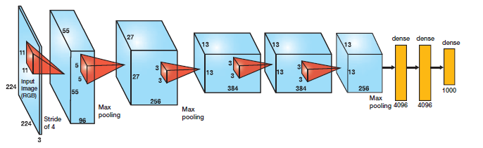
12
AlexNet Architecture

Slide 13
13
VGG
In 2014, it won the ImageNet Large Scale Visual Recognition Challenge (ILSVRC)
First to use 3X3 filters which could approximate the larger 11X11 or 9X9 filter used by ALexNet
Local Response Normalization not implemented

Slide 14
METHODOLOGY

Slide 15
15
Algorithm
Step 1: Start
Step 2: Load data
Step 3: Define the image pixel, channel, number of classes and epochs
Step 4: Perform data pre-processing
resize image to standard size
normalize the data

Slide 16
16
Algorithm (continued)
Step 5: Define architecture of the network
Step 6: Train the model
Step 7: Visualize and save model configuration
Step 8: Generate the plot of loss and accuracy

Slide 17
17
Algorithm (continued)
Step 9: Predict the class
Step 10: Stop

Slide 18
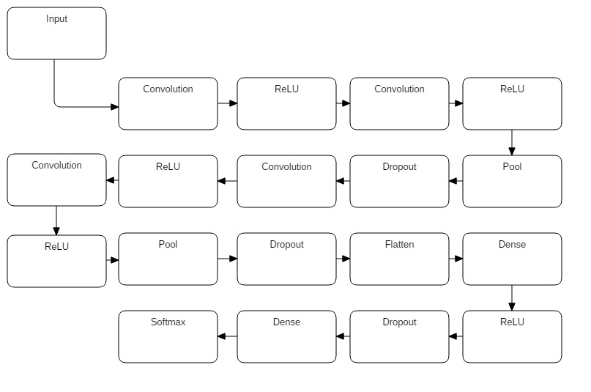
18
Architecture

Slide 19
19
Architecture (contd..)
Image loaded and resized to 32x32 pixels (if necessary)
Normalized by dividing value by 255
3x3 filter passed through entire image to extract feature map
First two convolutional layer uses 32 3x3 filters and the latter two use 64 3x3 filters

Slide 20
20
Architecture (contd..)
ReLU applied after each convolution and 2x2 maxpool utilized
Batch size used was 128 due to memory contraints
Number of epochs 20 yielded 70% validation accuracy
RMSprop used as optimizer
Dense layer with softmax function to generate vector of probabilities

Slide 21

Architecture (contd..)
Learning rate = 0.0001 and decay = 0.0
Dropout value following convolution layers = 0.25
Final Dropout value = 0.5 to reduce complexity
Cifar-10 dataset used for training the model

Slide 22
EXPCTED OUTPUT

Slide 23
23
Work Completed
Network trained with around 70% accuracy using large dataset
Configuration saved in .json file format and trained weights in .h5 format
Class of image can be predicted
Plot of accuracy and loss for both training and validation generated

Slide 24
24
Work Remaining
Fine tuning the model to achieve optimum accuracy
Design of interactive user interface
Error handling procedure remains
Increasing image classes from 4 to 10

Slide 25
25
Problem Encountered
Difficulty in understanding core concept of Convolutional Neural Network
Training time for large dataset is high
Some minor glitches occur now and then

Slide 26
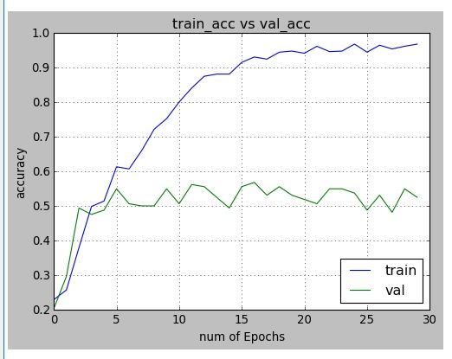
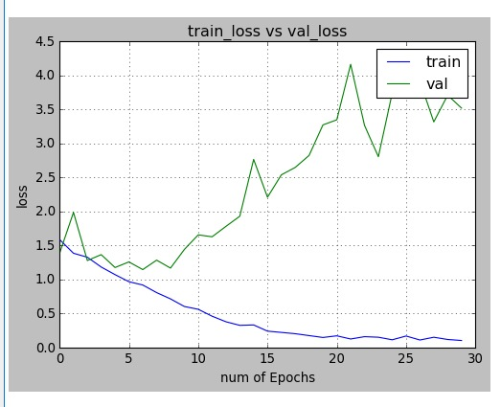
26
Previous Output

Slide 27
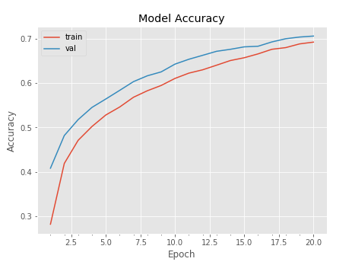
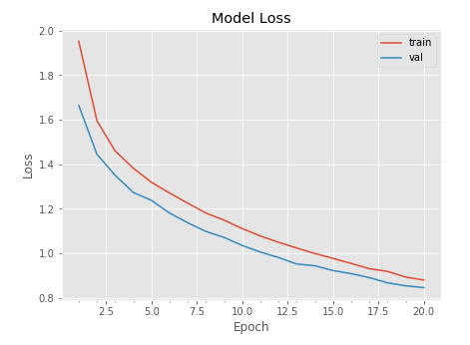
27
Current Output

Slide 28
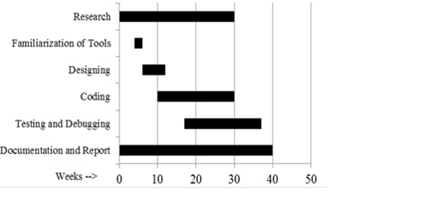
28
Work Schedule

Slide 29
THANK YOU!

